Slide 1
ARRAY

Slide 2
What are Arrays
The array is defined as a collection of similar data elements. If you have some sets of integers, and some sets of floats, you can group them under one name as an array. So, in simple words, we can define an array as a collection of similar types of values that are stored in a contiguous memory location under a single name.
C# supports two types of arrays:
Single dimension array
Multi-dimensional array
Single –dimensional array is arranged in the form of rows whereas multi-dimensional arrays the data is arranged in the form of rows and column
Multi-dimensional Arrays are of two types
Jagged array – whose rows and columns are not equal
Rectangular array – whose rows and columns are equal

Slide 3


How to declare an Array
<data type>[] VariableName = new <data type>[size of the array];
This will allocate space in the heap memory and will declare with the defaults of zero.
Declare and initialize an Array in the Same statement in C#
How can we access the Array Elements in C#
We can access array’s element by index. Indexes are going to start from zero to n-1.

Slide 4
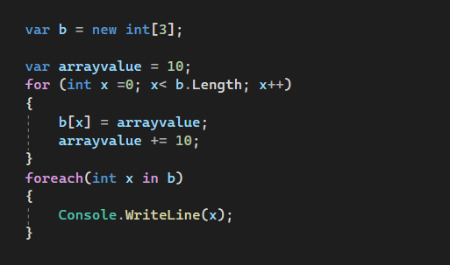

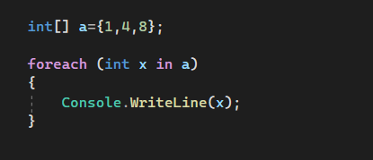

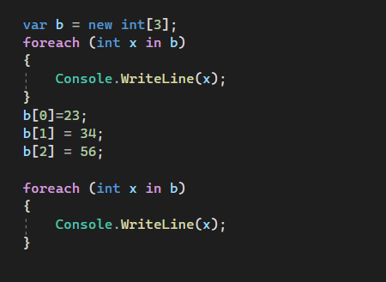


Slide 5
Difference between for Loop and Foreach
The loop variable refers to the index of an array whereas, in the case of a for-each loop, the loop variable refers to the values of the array.

Slide 6
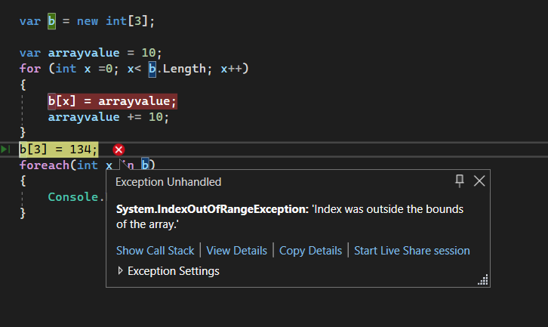
Accessing un- existing Index

Slide 7
Array Properties
IsFixedSize
Returns a Boolean value indicating whether the Array has a fixed size.(this is always true for all arrays). An array with a fixed size does not allow addition or removal of elements after the array is created , but allows modification of existing elements.
IsRead-only
This property is always false .and returns a value indicating whether the array is read-only. An array that is read-only does not allow addition, removal or modification of elements after the array is created.
Length
Get the total number of element in all the dimensions of the array
Rank
Gets the number of dimensions of an array . Example, one-dimensional returns 1 , a two –dimensional returns 2

Slide 8
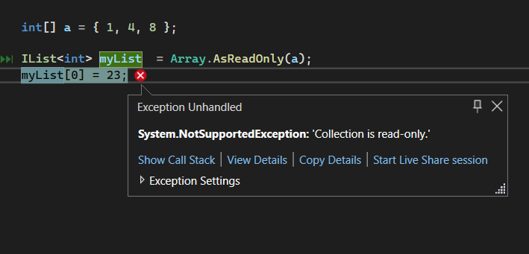
Array Methods
AsReadonly
Returns a read-only wrapper for the specified array.

Slide 9
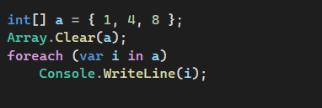

Clear
Clears the contents of an array

Slide 10
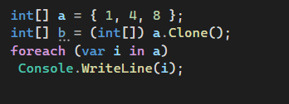

Clone
Shallow copies an array

Slide 11
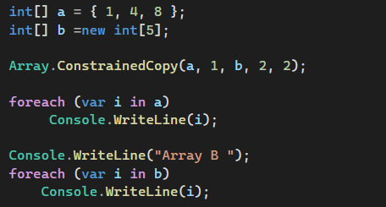
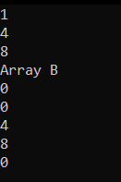
ConstrainedCopy
Copies a range of elements from an Array starting at the specified source index and pastes them to another Array starting at the specified destination index. Guarantees that all changes are undone if the copy does not succeed completely.
Parameters
sourceArray - (Array) -The Array that contains the data to copy.
sourceIndex (Int32) -A 32-bit integer that represents the index in the source Array at which copying begins.
destinationArray (Array) - The Array that receives the data.
destinationIndex (Int32) -A 32-bit integer that represents the index in the destination Array at which storing begins.
Length (Int32)A 32-bit integer that represents the number of elements to copy.

Slide 12
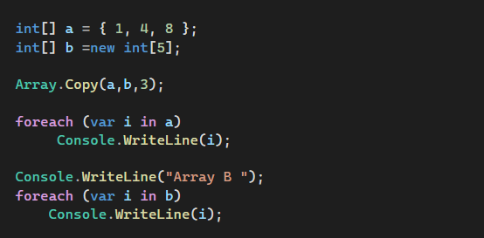
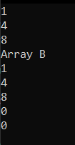
Copy
Copies a range of elements from an Array starting at the first element and pastes them into another Array starting at the first element. The length is specified as a 32-bit integer.

Slide 13
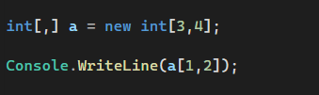

2-Dimensional Array
What is a Two-Dimensional Array.
Its an array that stores elements in the form of rows and columns.
They have two more types:
Rectangular array – The array whose rows and columns are equal.
Jagged Array – The array whose rows and columns are not equal.
How 2D array is created and Accessed in C#

Slide 14

What Happens is whenever we create an array this way:
Behind the scenes memory location are allocated continuously side by side .It will create a single dimension array of 12 , where the first 3 location are used as the first rows, the second four location are used as the second row and the rest four are used as the third row.
The compiler allows us to access this single-dimension array as a 2D array.

Slide 15
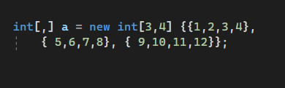
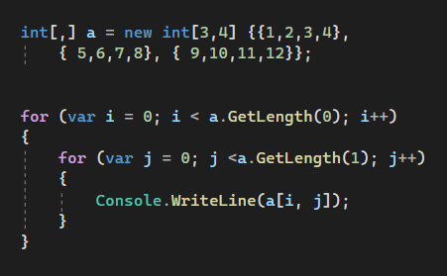

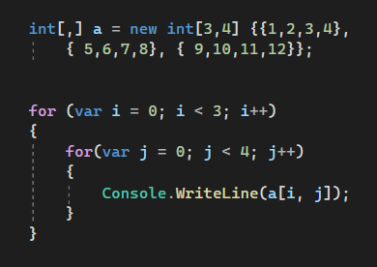
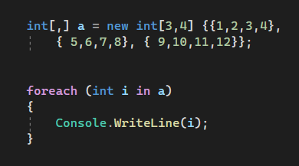
Initializing a 2 Dimensional Array in C#
Accessing The Elements

Slide 16


Jagged Arrays
These are also two-dimensional arrays that will also store the data in the forms of rows and columns. But here in the jagged array, the column size will differ from row to row.
To declare a jagged array in C#, at the time of its declaration, you only need to specify the number of rows that you want in the array. For example:
Above we specify that we want three rows, after this you need to initialize each row with the number of columns by using a single-dimensional array.

Slide 17
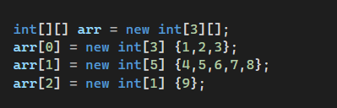
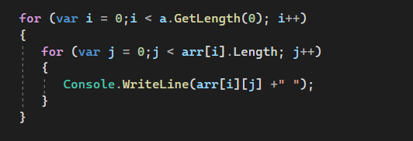

Accessing Elements in a Jagged Array

Slide 18
Advantages of Array
It is used to store similar types of multiple data items using a single name.
We can use arrays to implement other data structures such as linked lists, trees, graphs, stacks, queues, etc.
The two-dimensional arrays in C# are used to represent matrices.
The Arrays in C# are strongly typed. That means they are used to store similar types of multiple data items using a single name.

Slide 19
Disadvantages of Array
The array size is fixed. So, we should know in advance how many elements are going to be stored in the array. Once the array is created, then we can never increase or decrease the size of an array. If you want then we can do it manually by creating a new array and copying the old array elements into the new array.
As the array size is fixed, if we allocate more memory than the requirement then the extra memory will be wasted. On the other hand, if we allocate less memory than the requirement, then it will create a problem.
We can never insert an element into the middle of an array. It is also not possible to delete or remove elements from the middle of an array.

